Slide 1
Chapter 01: Evolution Programs for Sampling, Optimization and Searching
CSCI 4588/5588
Machine Learning II
- Md Tamjidul Hoque
Notes:
Conformational Sampling is extremely important for the Structure Prediction

Slide 2
Evolution Programs
Evolution is basically the change in the inherited characteristics of biological population over consecutive generations.
The Evolution Program is a probabilistic algorithm which maintains a population of individuals and observe the evolution within the population using some “genetic” operation(s).
We use a common term, Evolution Programs (EP), for all evolution-based systems, which maintain
a population of potential solutions,
have some selection process based on fitness of individuals,
and some “genetic” operators
The general structure of an Evolution Program is given next:
Notes:
Gene is the segment of a chromosome

Slide 3
… General structure of EP
Fig: The structure of an evolution program

Slide 4
… Solution by Searching using EPs
In general, any abstract task to be accomplished can be thought of as solving a problem, which, in turn, can be perceived as a search through a space of potential solutions.
Since we are (usually) after "the best" solution, we can view this task as an optimization process.
For small spaces, classical exhaustive methods usually suffice; for larger spaces special artificial intelligence techniques need to be employed.
Genetic Algorithms (GAs) are among such EPs techniques; they are stochastic algorithms whose search methods model some natural phenomena.
Hill-climbing and Simulated Annealing are also members of EPs.
Example:
To have some context, assume, the search space is a set of binary strings v of the length 30. The objective function f to be maximized is given as:
f (v) =|11· one(v) - 150|,
where the function one(v) returns the number of 1s in the string v.

Slide 5
… Solution by Searching using EPs
The function f is linear and does not provide any challenge as an optimization task. We use it only to illustrate the ideas behind these three algorithms.

Slide 6
… Solution by Searching using EPs
Hillclimbing Algorithm
One version of a simple (iterated) hillclimbing algorithm (MAX iterations) is given in next (see Figure) (steepest ascent hillclimbing).

Slide 7
… Solution by Searching using EPs
Fig. : A simple (iterated) hillclimber.

Slide 8
… Solution by Searching using EPs
It is interesting to note that the success or failure of the single iteration of the above hillclimber algorithm (i.e., return of the global or local optimum) is determined by the starting string (randomly selected).
It is clear that if the starting string has thirteen ls or less, the algorithm will always terminate in the local optimum (failure). The reason is that a string with thirteen ls returns a value 7 of the objective function, and any single-step improvement towards the global optimum, i.e., increase the number of ls to fourteen, decreases the value of the objective function to 4.
On the other hand, any decrease of the number of ls would increase the value of the function: a string with twelve ls yields a value of 18, a string with eleven 1s yields a value of 29, etc. This would push the search in the “wrong” direction, towards the local maximum.
For problems with many local optima, the chances of hitting the global optimum (in a single iteration) are slim.
Notes:
Defs:
Hyperparameter: In machine learning, a hyperparameter is a parameter whose value is set before the learning process begins. By contrast, the values of other parameters are derived via training.
Metaheuristic: A metaheuristic is a higher-level procedure or heuristic designed to find, generate, or select a heuristic
Heuristic: Heuristic is any approach to problem solving or self-discovery that employs a practical method, not guaranteed to be optimal, perfect, or rational, but instead sufficient for reaching an immediate goal.

Slide 9
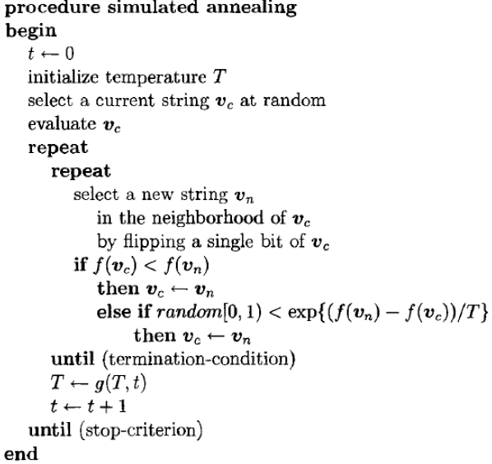
… Solution by Searching using EPs
Simulated Annealing (SA)
SA is a probabilistic metaheuristic for the global optimization problem of locating a good approximation to the global optimum of a given function in a large search space.
The key difference in SA is, it can accept relatively much worse solution depending on relatively higher temperature T of the system.
The temperature T is lowered in steps (g(T, t) < T for all t). The algorithm terminates for some small value of T: the (stop-criterion) checks whether the system is ‘frozen’, i.e., virtually no changes are accepted anymore.
Fig. 3: Simulated Annealing
Notes:
Notation: x ∈ [0,1) => 0 ≤ x <1 [Note: if there were, x=1 condition, then there will be no use to evaluate right side of the inequality equation of the else condition;
but for ‘0’ it is possible to have ‘0’ generated from right side to be compared ]
For the else condition f(vc) > f(vn) [i.e.; the current is better than the new solution]
So, if r=[f(vn)-f(vc)], r is always negative. And, if T is relatively higher (compare to T’s other possible values), then the “e^[r/T]” will be relatively higher.
For example, with r=-11, and T=20 and T=100, we will respectively have,
(e^(-11/20)) and (e^(-11/100))
or, (e^-0.55) and (e^-0.11)
or, (0.57694981) and (0.89 5834135).
Note: when T = 20, we have RHS = 0.57694981,
and when T =100, we have RHS = 0.895834135.

Slide 10

… Solution by Searching using EPs
Simulated Annealing (SA)
Q: How can SA escape local minima?
p = $e^{− \frac{11}{20}}$ = 0.57695,
i.e., the chances for acceptance are better than 50%.

Slide 11
… Solution by Searching using EPs
Genetic Algorithms
Fig: Pseudo code for Genetic Algorithm
Genetic algorithms (see Figure above), can maintain a population of strings. Two relatively poor strings, for example:
each of which evaluate to 4, can produce much better offspring (if the crossover point falls anywhere between the 5th and the 12th position):

Slide 12
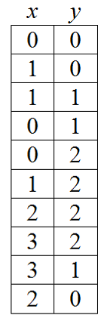
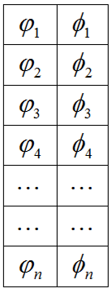
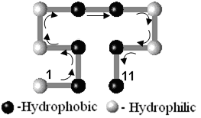

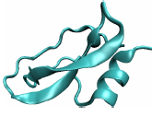
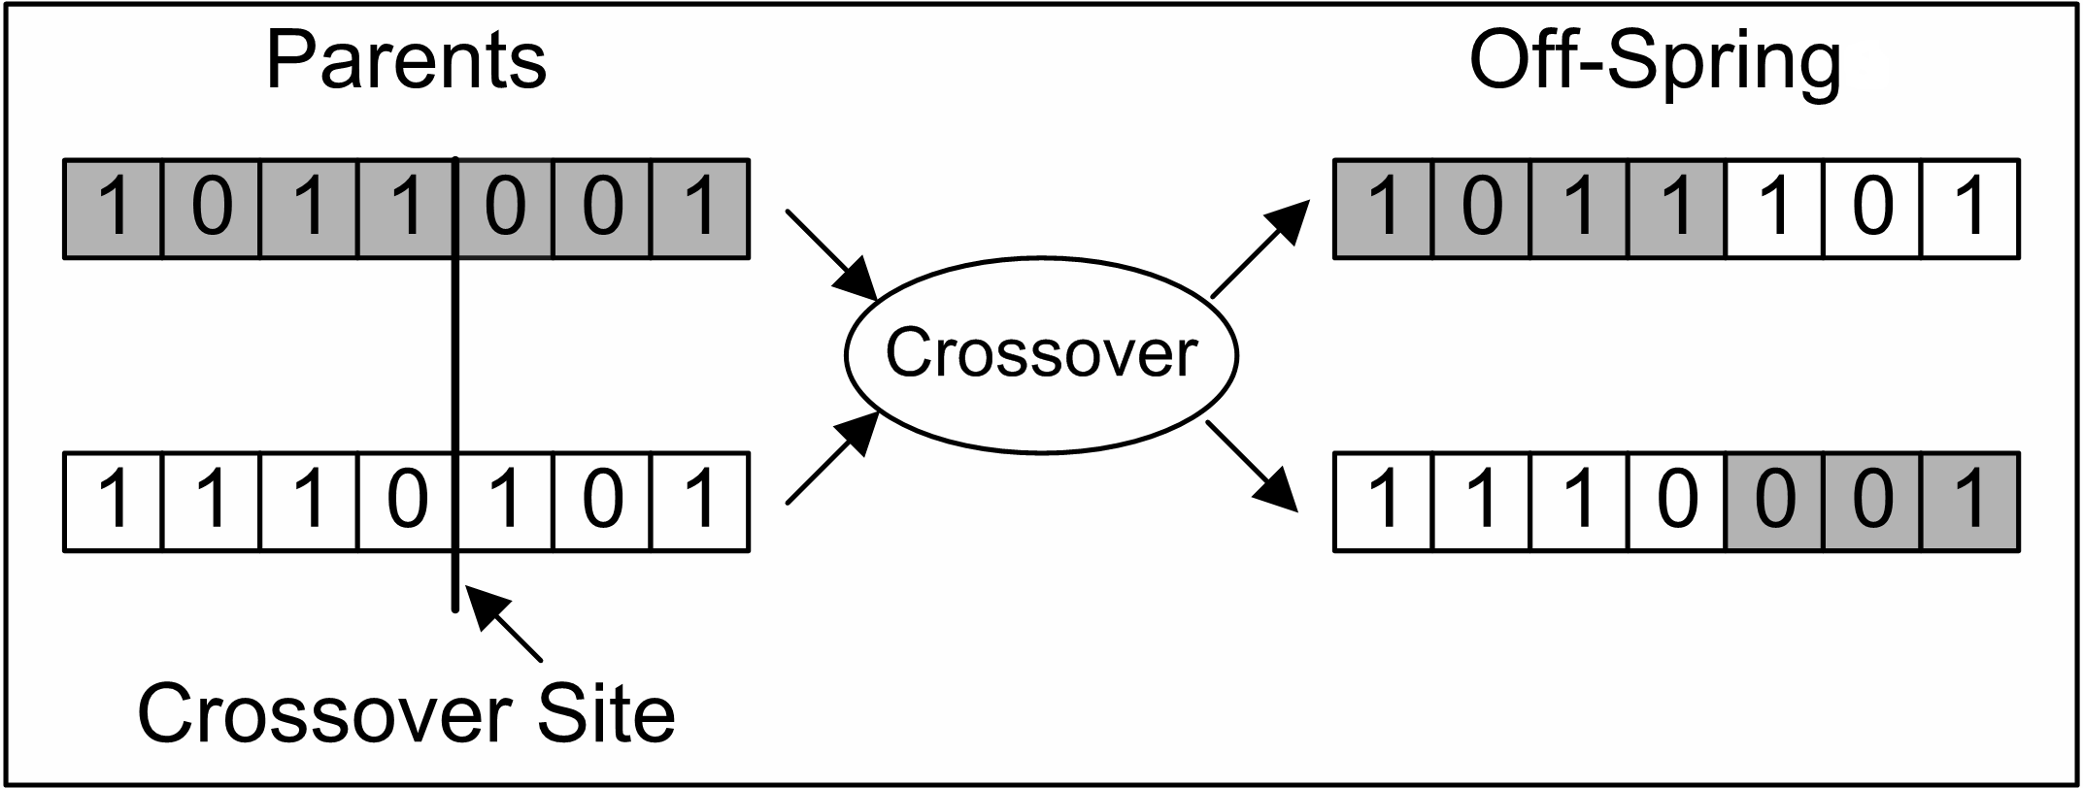
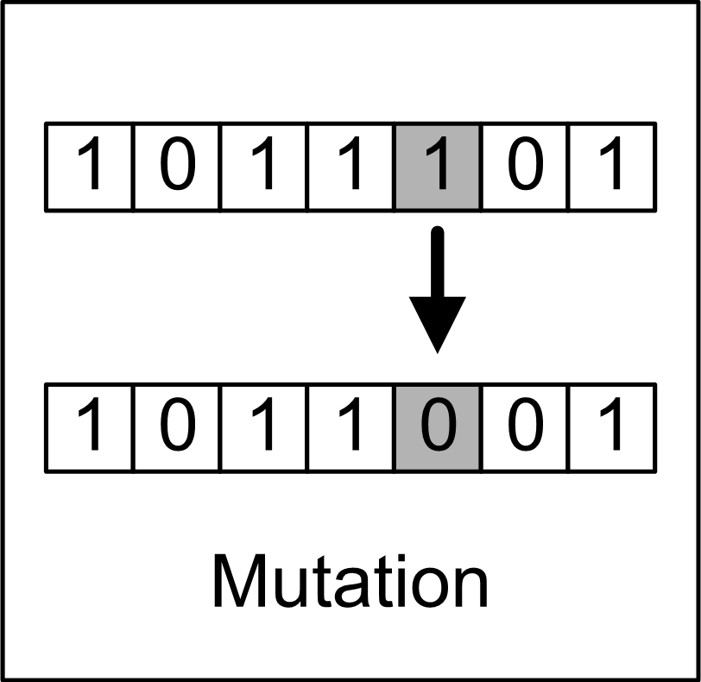
Genetic Algorithm (Basic)
Major Components: Chromosomes, Population, Crossover, Mutation, …
Coding:
Or,
Three different arrows are indicating Left (0), Right (1) and Forward (2). Encoded Chromosome can be:
Crossover
Mutation
Notes:
Gene is the segment of chromosome

Slide 13
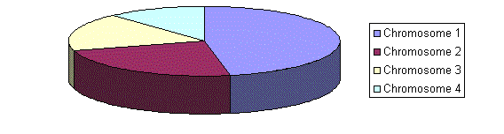
Selection Procedures
Roulette Wheel Selection
Figure: A marble is thrown and selects the chromosome. Chromosome with bigger fitness will be selected more times.
2. Rank Selection
Rank selection first ranks the population and then every chromosome receives fitness from the ranking.
Other option: Steady State Selection (which is close to elitism)
Recommended GA parameters
Crossover rate = 80 to 90%, at least 60% required
Mutation rate = 0.5 to 5 %
Elite rate = 5 to 10%
Notes:
RWS: Parents are selected according to their fitness. The better the chromosomes are, the more chances to be selected they have. Imagine a roulette wheel where are placed all chromosomes in the population, every has its place big accordingly to its fitness function, like on the following picture.

Slide 14
Some of the Latest Heuristic Algorithms
Particle Swarm Optimization (PSO),
Artificial Colony Optimization / Ant Colony Optimization (ACO),
Differential Evolution (DE),
Artificial Bee Colony (ABC),
Glowworm Swarm Optimization (GSO),
Cuckoo Search Algorithm (CSA),
Firefly Algorithm (FA),
Bat Algorithm (BA),
Monkey Algorithm (MA),
Krill Herd Algorithm (KHA),
Wind Driven Optimization (WDO),
Social Spider Algorithm (SSA),
Artificial Immune Systems,
Conformational Space Annealing,
…

Slide 15

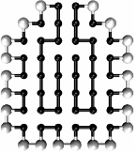
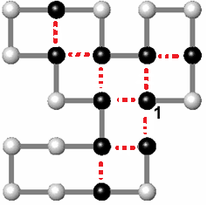
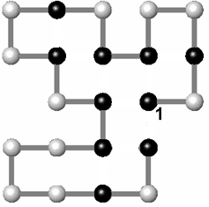
Simplified PSP Challenge
2D HP model: H for hydrophobic ( ) and P for hydrophilic ( ) residue in HP model.
Chain:
Optimal Fitness -9.
Chain Length 20.
Optimal Fitness -42.
Chain Length 64.
Do we have a feasible solution for longer sequences, say 70 or higher residues long?
Notes:
Imagine how much effort and computing efficiency we will require here as well as for the real protein structure prediction!

Slide 16
Complexity
- Hydrophobic (H) or non-polar residues stay away from water (water-hating), and tend to be inside the protein core.
- while, the hydrophilic or polar (P) residues are attracted towards water (water-loving), and hence tend to remain outside the protein core.
Valid Sequence: Self avoiding walk (SAW)
-- How many? Ans:
where,
= 4.68401 for Simple lattice
e.g. in 2D, if n = 40
2 860 274 487 506 831 970 500 921 533, possible.
Earth Surface = 510, 072, 000, 000, 000 m² → 5,607,589,688, 332 earths to hold one conformation in 1 m² of earth surface.

Slide 17
Outline of the presentation for GA
Schema th^{m} based Theoretical Extension of GA
Optimal CCF based Twin-Removal GA (TRGA)
Cache-Memory based Fast-Navigating GA (FNGA)
Mixed-Mode Combination(FNGA, TRGA) => KGA
KGA => Parametric KGA (k, p)

Slide 18
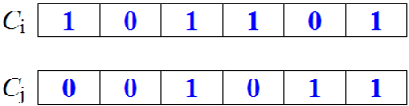

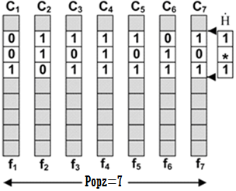
Schema and Schema Theorem
Alphabet set {0, 1}
Schema, H
Alphabet set {0, 1, *}, * = don’t care
Length of schema δ (H) = δ (*01**1) = 4 [Count of crossover positions which can change the schema]
Order of schema o(H) = o (*01**1) = 3 [Number of non-‘*’, flipping which change schema]
m (H, t) = number occurrences of schema H in a population size Pop_{z} at time t.
Figure: m(H, t) = 4, where H=[1*1] in C₃, C₄, C₅ and C₇, Generation = t, Pop_{z} = 7.

Slide 19
… Schema and Schema Theorem
Possible number of schema from chromosome of length n =>
Thus, for a Population size, Pop_{z}, chromosomes evaluates schema
Say, Pop_{z} = 200, A = 2, n = 40, evaluated schema count = 2431533091811385760000
=> Implicit Parallelism

Slide 20
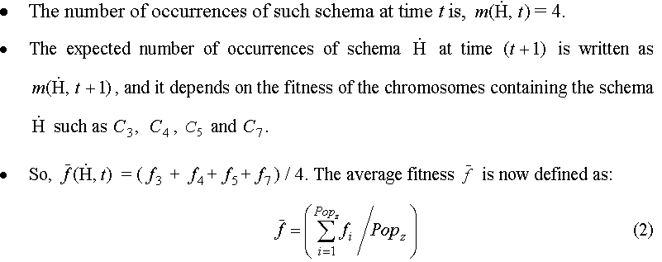
Figure: m(H, t) = 4, where H=[1*1] in C₃, C₄, C₅ and C₇, Generation = t, Pop_{z} = 7.

Slide 21
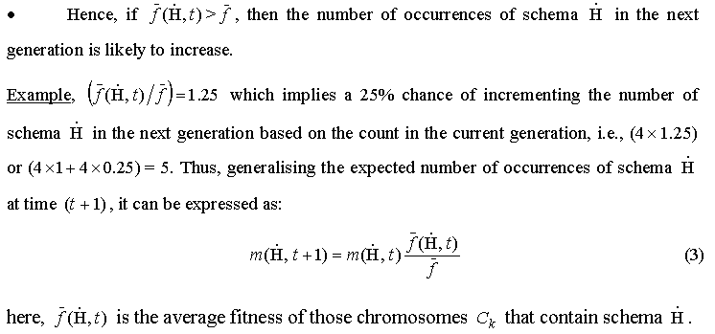

Slide 22
… Schema and Schema Theorem
Existence Probability of Schema from Crossover
δ (H) = 2
C_{i}
(n-1)
The lower bound of the existence probability p_{e} having crossover probability p_{c} is given by:

Slide 23
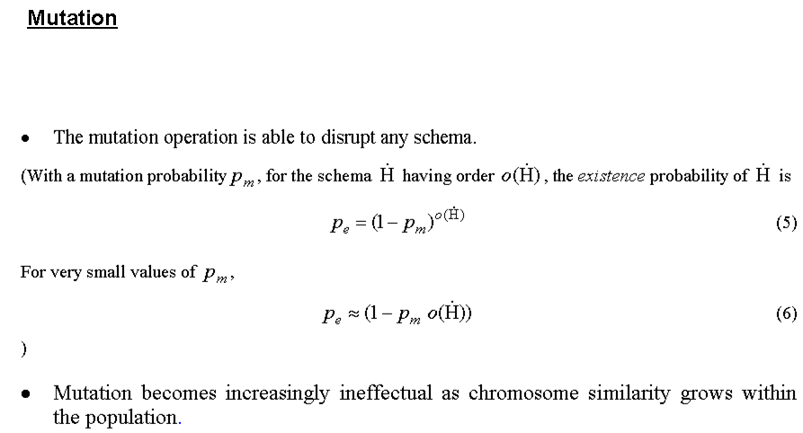
Notes:
The 1st equation is saying the higher the order of scheme the low the existence probability and to compute that we obviously have to take the product.
The more product we take the lesser the probability of existence becomes.

Slide 24

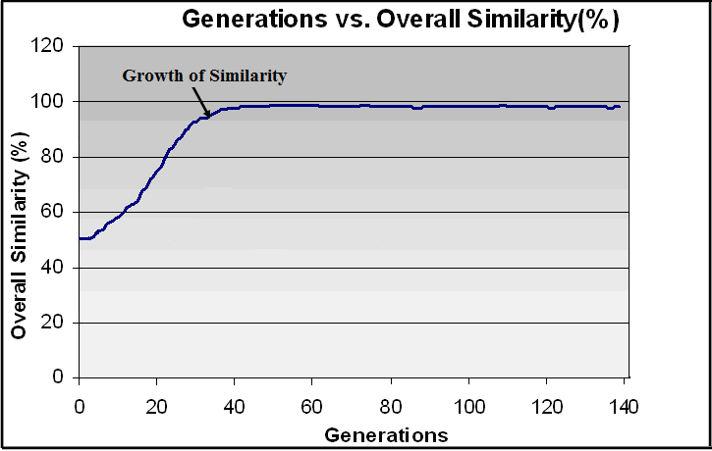
Original and Complete form of the Schema Theorem
The number of schema H in next generation (t+1) is expressed as:
Comes from an inequality equation and the assumption is based on disruption probability
Notes:
assume that the conformations of all the chromosomes having the same fitness are same, i.e. . So, the same outcome will be achieved by selecting any of these for operations such as crossover or mutation. Now consider the fitness based proportional pie-chart, shown in Figure 3.2 (b), where fitness 5 occupies 68% in total, so the probability of a rolling marble randomly selecting a pie slot having fitness 5 can be expressed as . The effective selection probabilities for, (or or or , and are thus 7/30, 20/30, 2/30 and 1/30 respectively. The fallacy in this example is that the selection probability of a chromosome having fitness 5 is actually higher than a chromosome having fitness 7 which is not reflected by Equation 1.

Slide 25
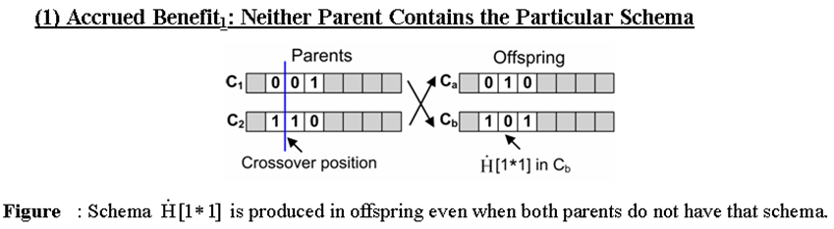
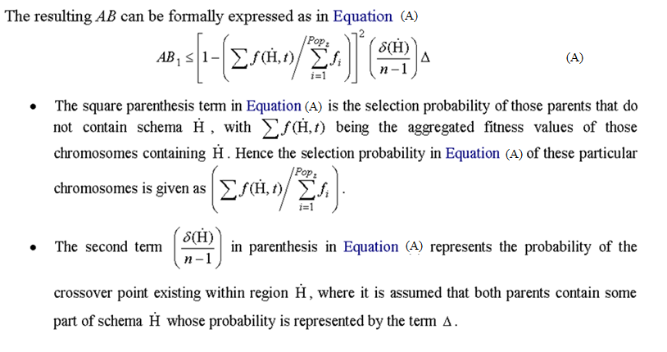
Cases: With crossover Schema is not Disrupted

Slide 26
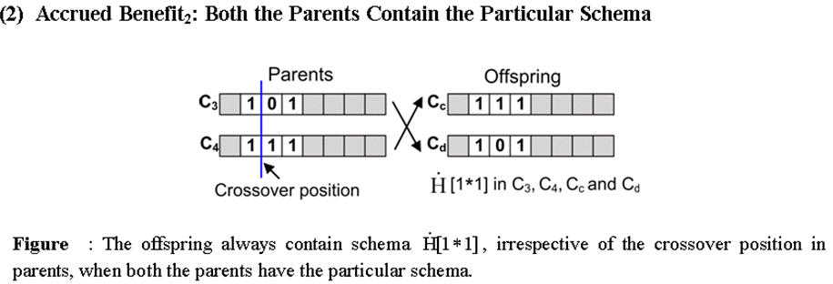
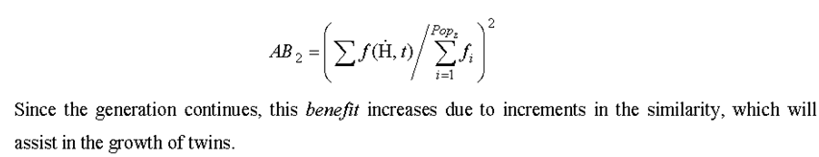

Slide 27
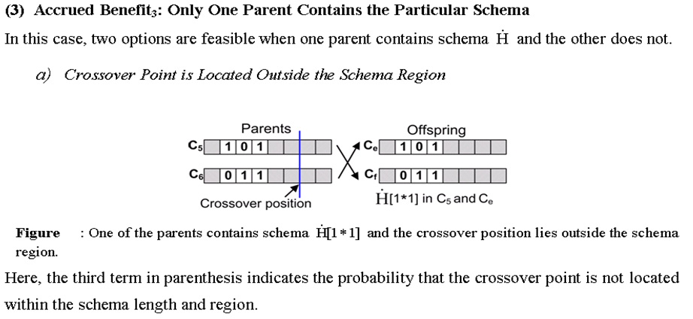
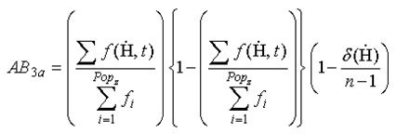

Slide 28
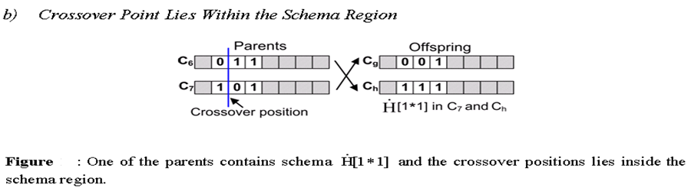
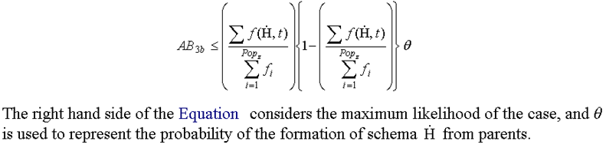


Slide 29
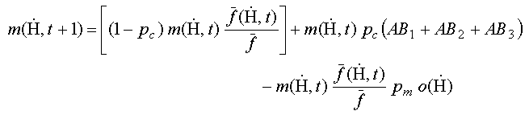
Final Form of the Extended Schema Theorem [2]
The accrued benefit (AB) terms clarify the increasing rate of growth of similarity with in GA population.
Based on the above guideline and empirical values we found CCF=0.8 is optimal.
CCF: We define twins using chromosome correlation factor which broadened not only to include identical but also similar or, correlated chromosomes in the population. A chromosome correlation factor (CCF) defines the degree of similarity existing between chromosomes.
M. T. Hoque et al, in Pattern Recognition in Bioinformatics, 2007.
M. T. Hoque et al., IEEE/ACM Transactions on Computational Biology and Bioinformatics (TCBB), 2011

Slide 30
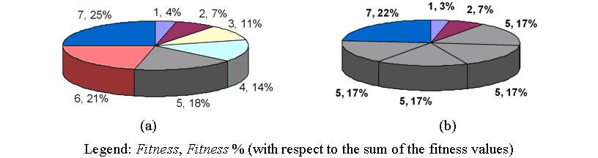
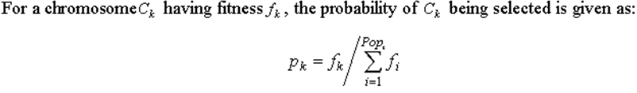
Fallacy in the Selection Procedure:
Selection
First Case : p₁ =(7/28), p₂=(6/28), p₃ = (5/28), …
Second Case : p₁ =(7/30), p₂=(20/30), p₃ = (2/30), …

Slide 31
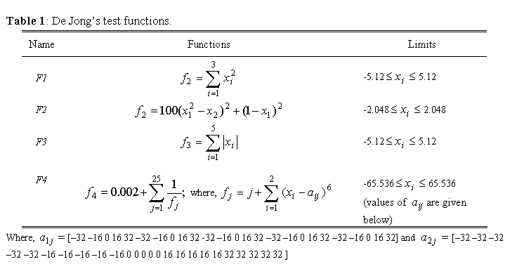
Simulation and Results
A number of categories of problems has been tested – we used:
(1) GA benchmarks equation, (2) PSP benchmark sequences, and (3) PDB sequences [3]

Slide 32
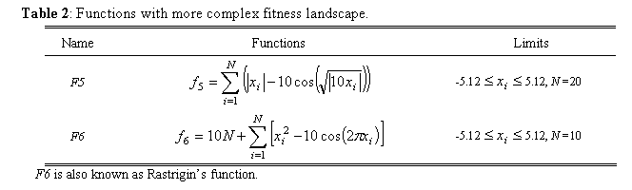
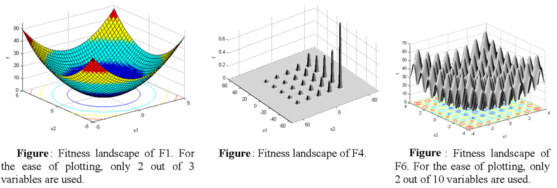
Continue…Simulation and Results

Slide 33

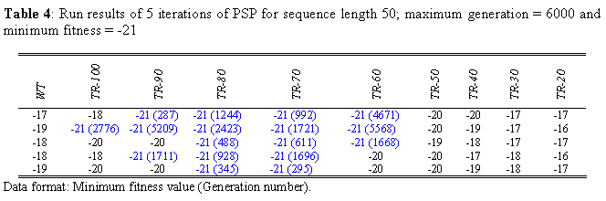
Continue…Simulation and Results

Slide 34
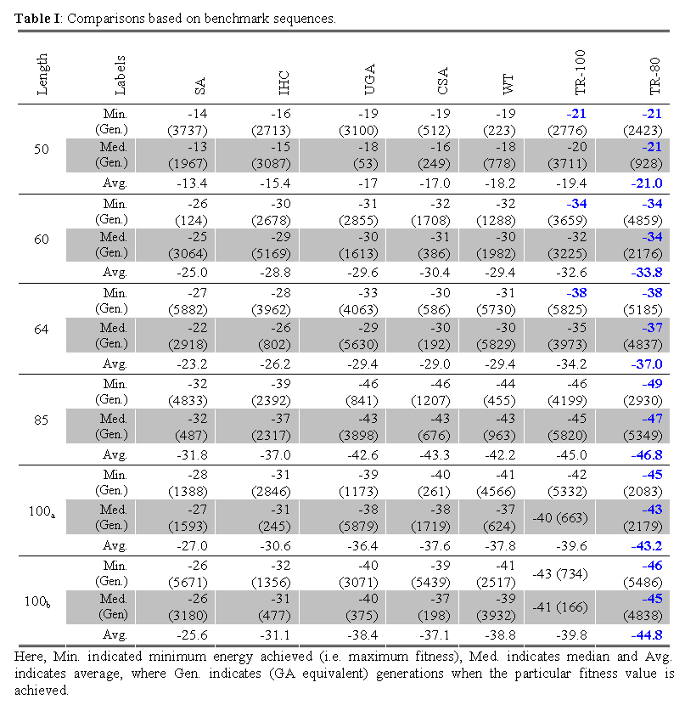
M. T. Hoque et al., IEEE/ACM Transactions on Computational Biology and Bioinformatics (TCBB), 2011

Slide 35
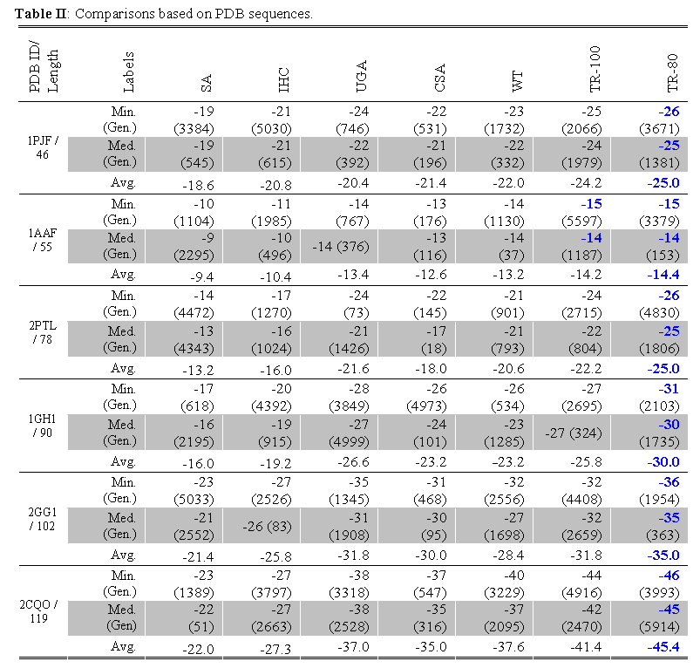

Slide 36
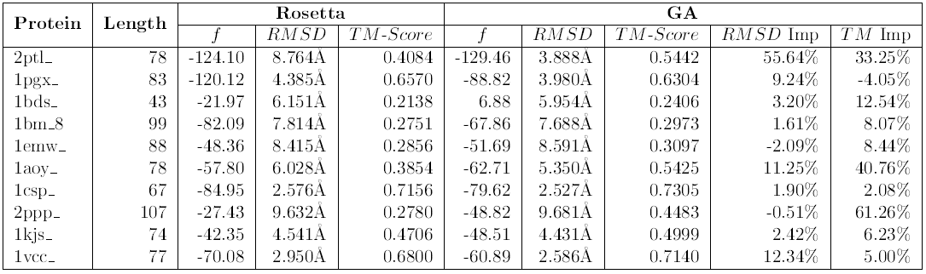
Resampling using TRGA: Test1
TRGA results compared to Rosetta by resampling Rosetta’s output
‘RMSD Imp’ → the RMSD improvement, and
‘TM Imp’ → TM-Score Improvement.
The average RMSD improvement was 9.5% and
the average TM-Score improvement was 17.36%.
Higgs, Bela, Hoque et al (2012) BiCoB. Las Vegas, USA: 239-244
Higgs, Bela, Hoque et al (2012), BIOINFORMATICS2012
Higgs, Bela, Hoque et al (2012), IEEE CEC 2012

Slide 37
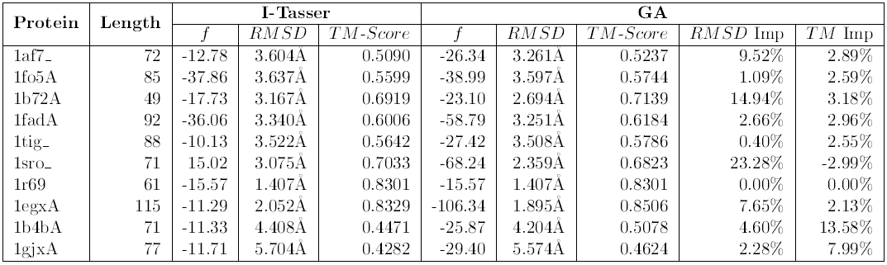
Resampling using TRGA: Test2
TRGA Results compared to I-TASSER by resampling I-TASSER’s output
The average RMSD improvement is 6.64%
and the average TM-Score improvement is 3.49%.

Slide 38
Outline of the Developed Genetic Algorithm
Schema th^{m} based Theoretical Extension of GA
Optimal CCF based Twin-Removal GA (TRGA)
Cache-Memory based Fast-Navigating GA (FNGA)
Mixed-Mode Combination(FNGA, TRGA) => KGA
KGA => Parametric KGA (k, p)

Slide 39
Associated memory based fast converging GA
Development of FNGA
Figure: Crossover Operation in FN-GA (FNGA).
M. T. Hoque, “Genetic Algorithms based Improved Sampling ,” under preparation, 2014

Slide 40
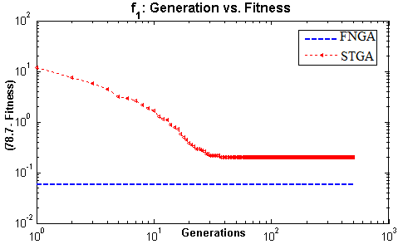
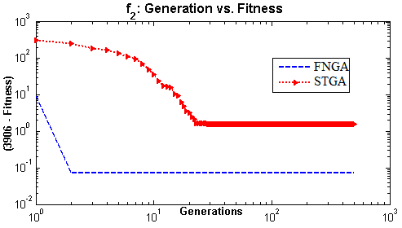
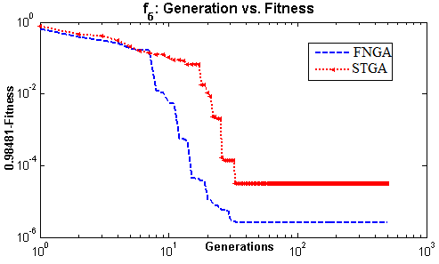
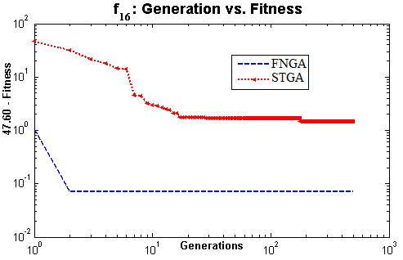
FNGA versus SawToothGA (STGA)
Total of 17 bench mark mathematical equations: Unimodal (1 to5), Multimodal (6 to12) and Non-linear Square Test functions (13 to 17)

Slide 41
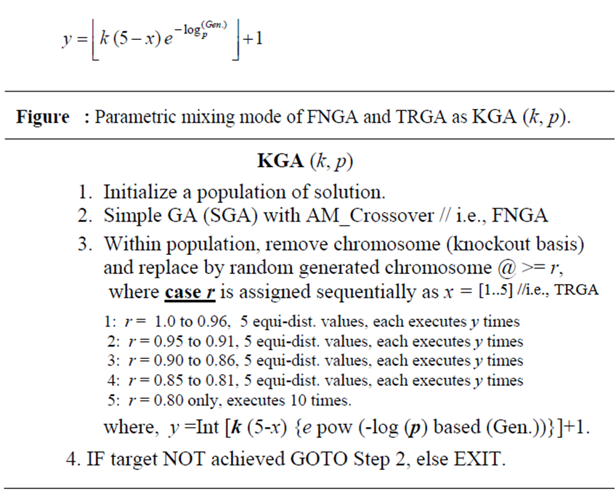
Development of KGA
KGA = FNGA + TRGA (mixed mode combination)
KGA => Parametric KGA (k, p)
FNGA
TRGA
KGA outperformed all the math equations and benchmark sequences

Slide 42
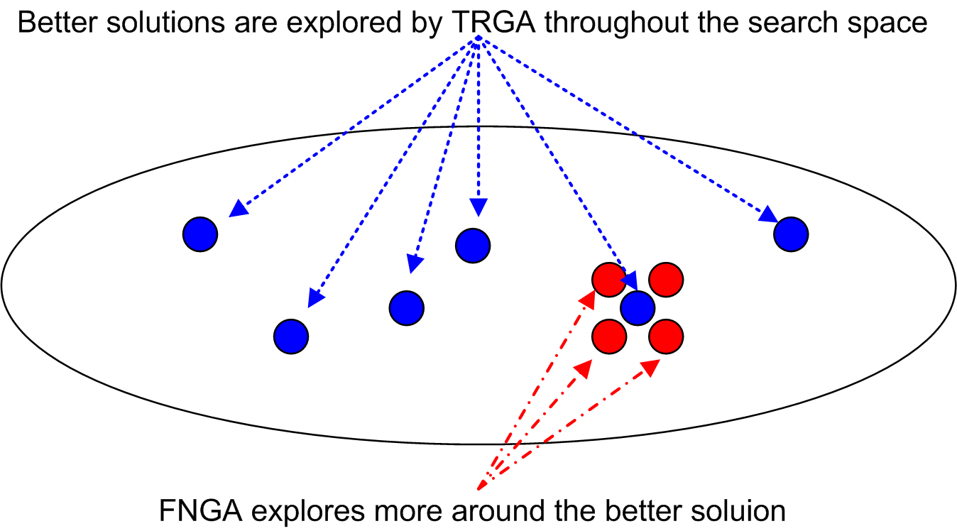
How does KGA work?
KGA = FNGA + TRGA

Slide 43
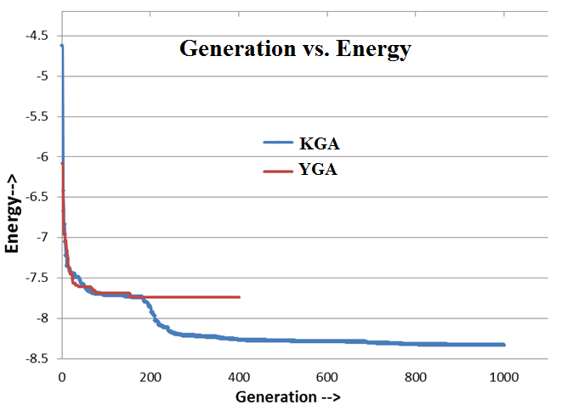
KGA versus YGA
KGA versus YGA in real ab initio Protein Structure Prediction test
Figure : KGA versus YGA, in getting lower energy minimum. PDB ID: 1b72, 49 residues long.
Ref (YGA): E. Faraggi, Y. Yang et al, Structure, Cell, Volume 17, Issue 11, 1515-1527, Nov 2009

Slide 44
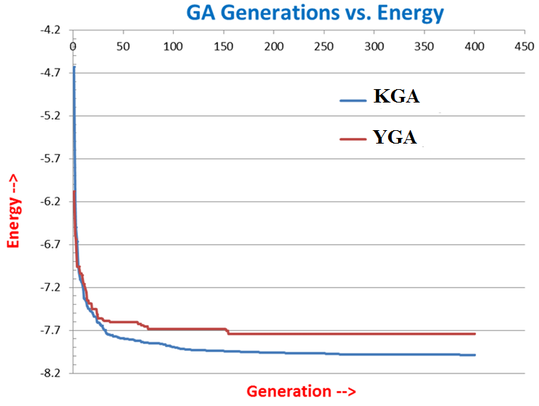
PDB ID: 2reb, 60 residues long
Figure : KGA versus YGA, in getting lower energy minimum.

Slide 45
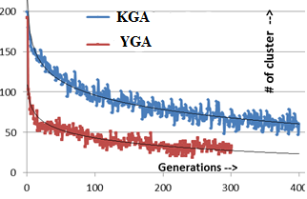
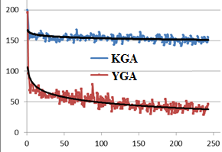
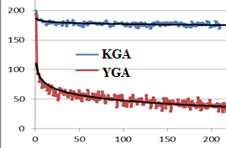
Sampling Diversity based Comparisons
(a)
(b)
(c)
Figure: PDB ID: Length (a) 1b72:49, (b) 2reb:60 and (c) 1af7:72.
Comparing KGA versus YGA for sampling diversity which is based on generation versus new structure cluster at least of 2.5 A apart.
* By the way, Parallel implementation is easy for GA.

Slide 46
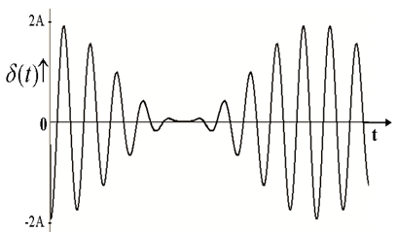
Multi-Objective Optimization for Lattice Protein
where, F= fitness, VF= virtual fitness
For changing weight of α and β alternatively, we use the following oscillating function,
where
, t = number of generation.
A typical value, A=30,
= 0.05
= 0.004
The assignment of α and β are as→

Slide 47
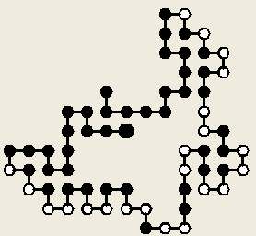
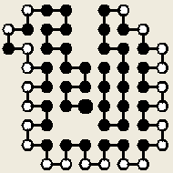





Multi-Objective Optimization for Lattice Protein
Generation/TF/F = 1/-23/-15 | 16/-33/-20 | 554/-49/-33
586/-404/-26 | 3249/-54/-38 | 5551 / -500/-32
Initial random
α > β
α > β
Final Output
α > β
α < β
α < β
Generation / F= 5646 / -42
--------- x ---------

